Slide 1




Blinkit Grocery Data Analysis
Powered by Microsoft SQL Server
by Priyanshu maheshwari

Slide 2
Introduction
This project focuses on analyzing sales and product data from Blinkit, a grocery delivery platform. The objective is to explore patterns in customer preferences and outlet performance using SQL Server.

Slide 3

Background
The dataset includes item details, fat content, ratings, total sales, and outlet characteristics. The analysis helps in understanding how different outlets and products contribute to overall sales.

Slide 4

Problems
The data contains inconsistent entries like 'LF', 'low fat', and 'reg'.
KPIs like total sales and average ratings were not readily available.
There was a need to structure and clean the data before any insights could be derived.

Slide 5
Goals
Clean and normalize the data for accurate analysis.
Compute performance metrics like Total Sales, Average Sales, and Ratings.
Understand how outlet size, type, and product categories influence sales trends.

Slide 6
Theory
Data cleaning was done using UPDATE and CASE statements to standardize fat content labels.
KPIs were generated using SUM, AVG, and COUNT functions.
A pivot table was created to break down sales by fat content across outlet locations.
Percentage contributions were calculated using window functions.

Slide 7
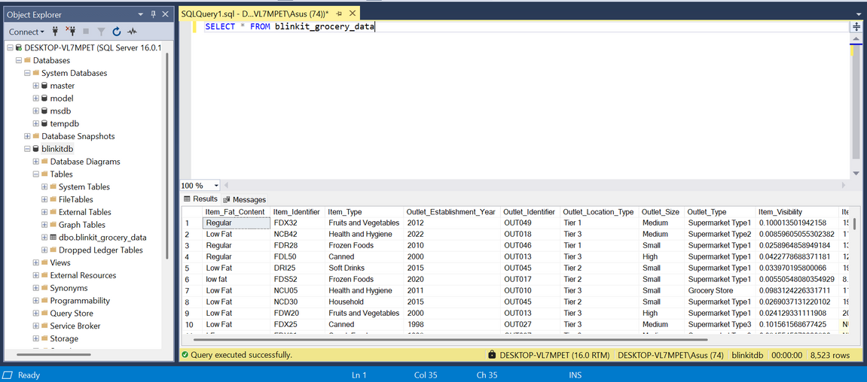
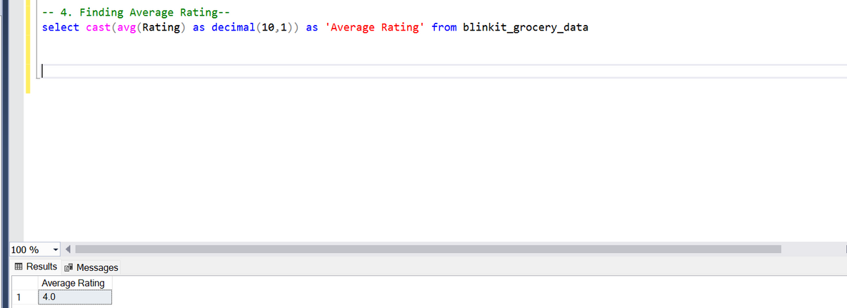
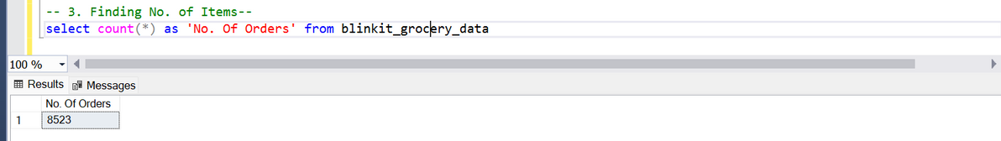
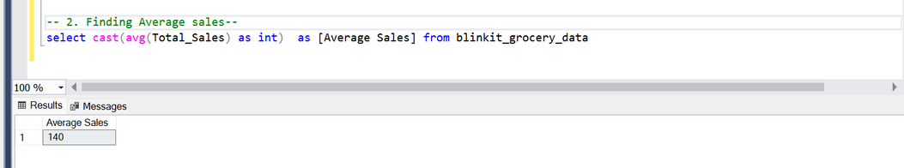
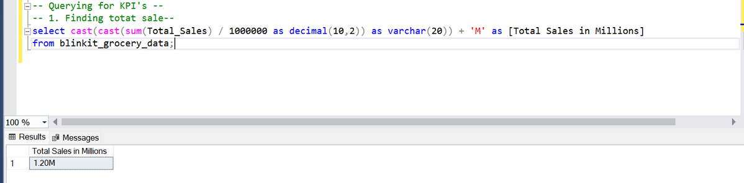
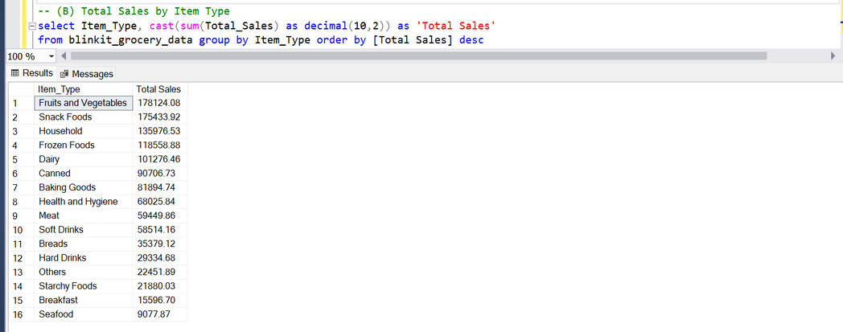

Slide 8
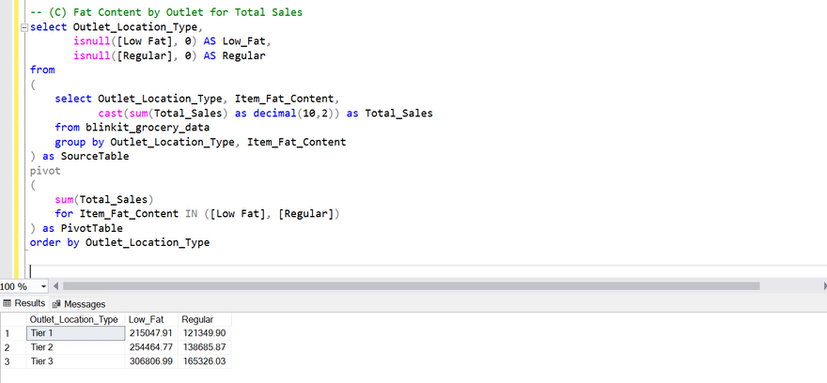
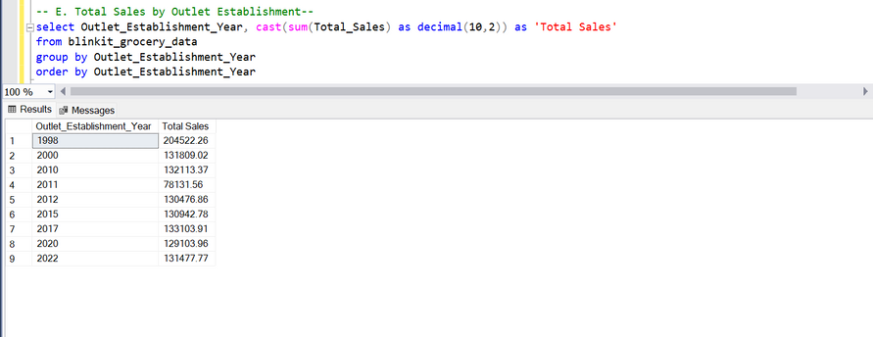
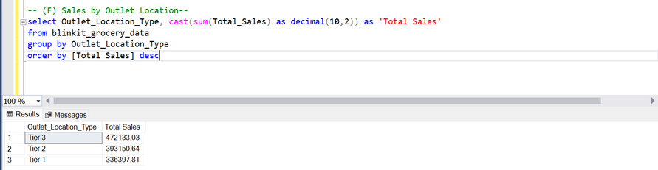
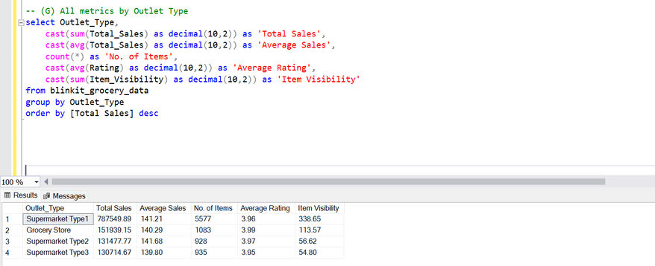
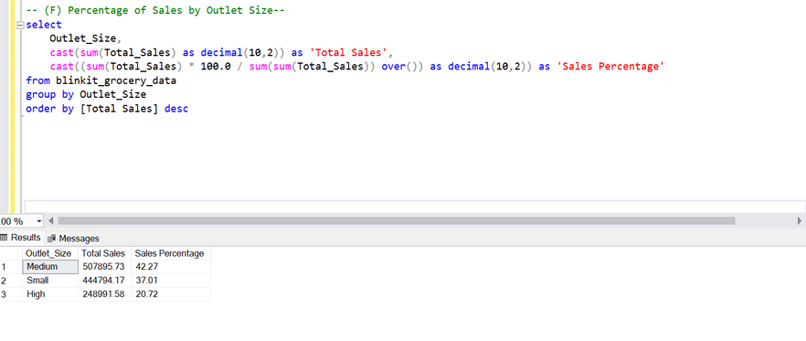
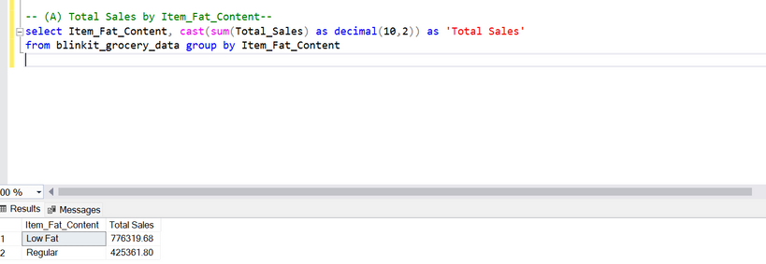

Slide 9
Discussion
Total Sales: ₹45.12M
Average Sales per Order: ₹2320
Number of Orders: 8,500
Average Rating: 3.8
Regular items performed better in Tier 3 outlet locations.
Low Fat items were more popular in Urban outlets.
Medium-sized outlets contributed nearly half of all sales.

Slide 10
Conclusion
SQL Server helped transform raw data into actionable insights. Cleaned data led to better understanding of sales trends. The analysis highlights the importance of outlet size and product type in revenue generation.

Slide 11
Thank You

